Slide 1


Dashtoon: Lightning Fast Comic Revolution
TARUN KURAKULA
IIT KANPUR
Dashtoon stands at the forefront of innovation, reshaping the landscape of comic creation through the power of Generative AI. This platform is a beacon for storytellers, providing them with unparalleled tools to effortlessly craft digital comics. In a world where artistic skills often pose a barrier, Dashtoon emerges as a catalyst, enabling creators to translate their narratives into captivating visual stories with unprecedented ease and speed.

Slide 2

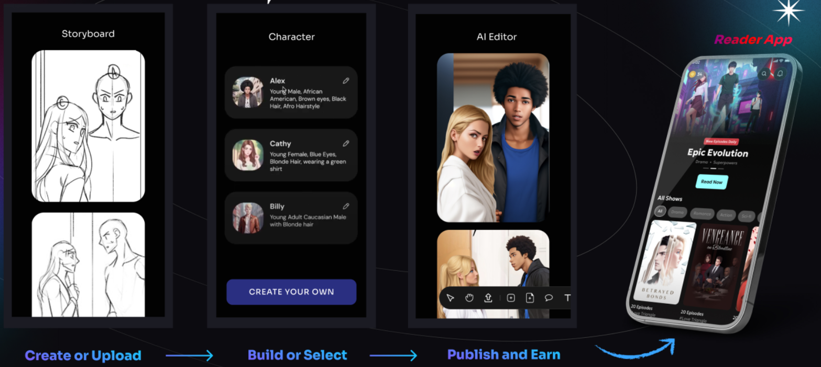
Key Features Of Dashtoon:
Generative AI Tools for Storytellers:
Dashtoon empowers storytellers with cutting-edge generative AI tools, allowing them to bring their narratives to life without the need for advanced artistic skills.
Daily Release of New Episodes on Dashtoon Comic Reader:
Experience a daily dose of creativity with Dashtoon's commitment to releasing new episodes regularly on the Dashtoon Comic Reader platform, keeping audiences engaged and entertained.
Frequent Updates (Almost 1,000 new episodes monthly):
Stay at the forefront of content with Dashtoon's impressive frequency, introducing nearly 1,000 new episodes each month, ensuring a continuous flow of fresh and exciting stories.
Freemium Model with One Free Daily Episode:
Dashtoon adopts a user-friendly freemium model, providing users with access to one free daily episode, making high-quality digital comics accessible to all.
Dashtoon Studio for Comic Creation:
Unleash your creativity with Dashtoon Studio, a feature-rich platform where creators can effortlessly translate ideas into visually stunning digital comics. Reduce creation time from 40-50 hours to just 5-6 hours, making comic creation efficient and enjoyable.

Slide 3



Comparative Analysis: Dashtoon vs. Competitors
Features
Points of Differentiation (PODs)
AI-powered creation tools
Daily episode release rate
Native creator community
Yes
No
No
No
Yes
No
No
No
Yes
No
No
No
Points of Parity (POPs)
Freemium model with in-app purchases
Vast library of comics
Yes
No
Yes
Yes
Yes
Yes
Yes
Yes
Target audience
Existing writer communities
Fans of Marvel comics
Fans of serialized webcomics
Fans of webcomics and other creative content

Slide 4




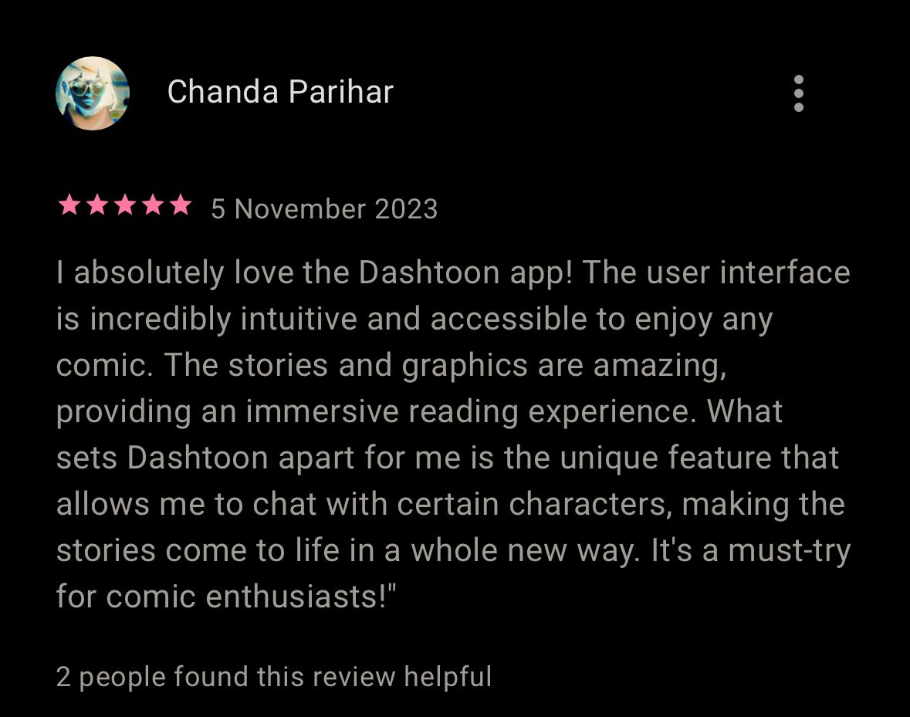

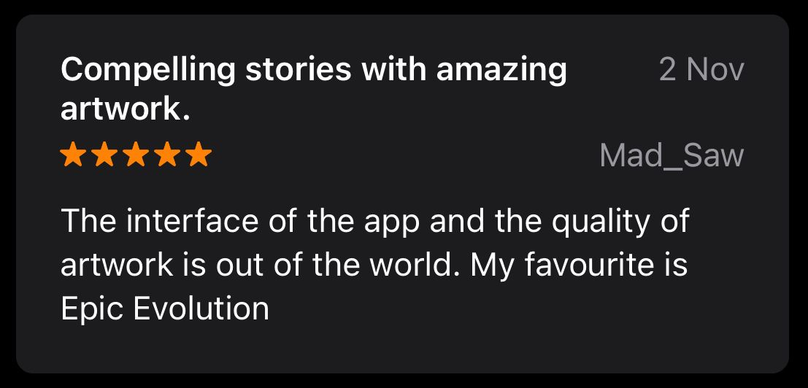

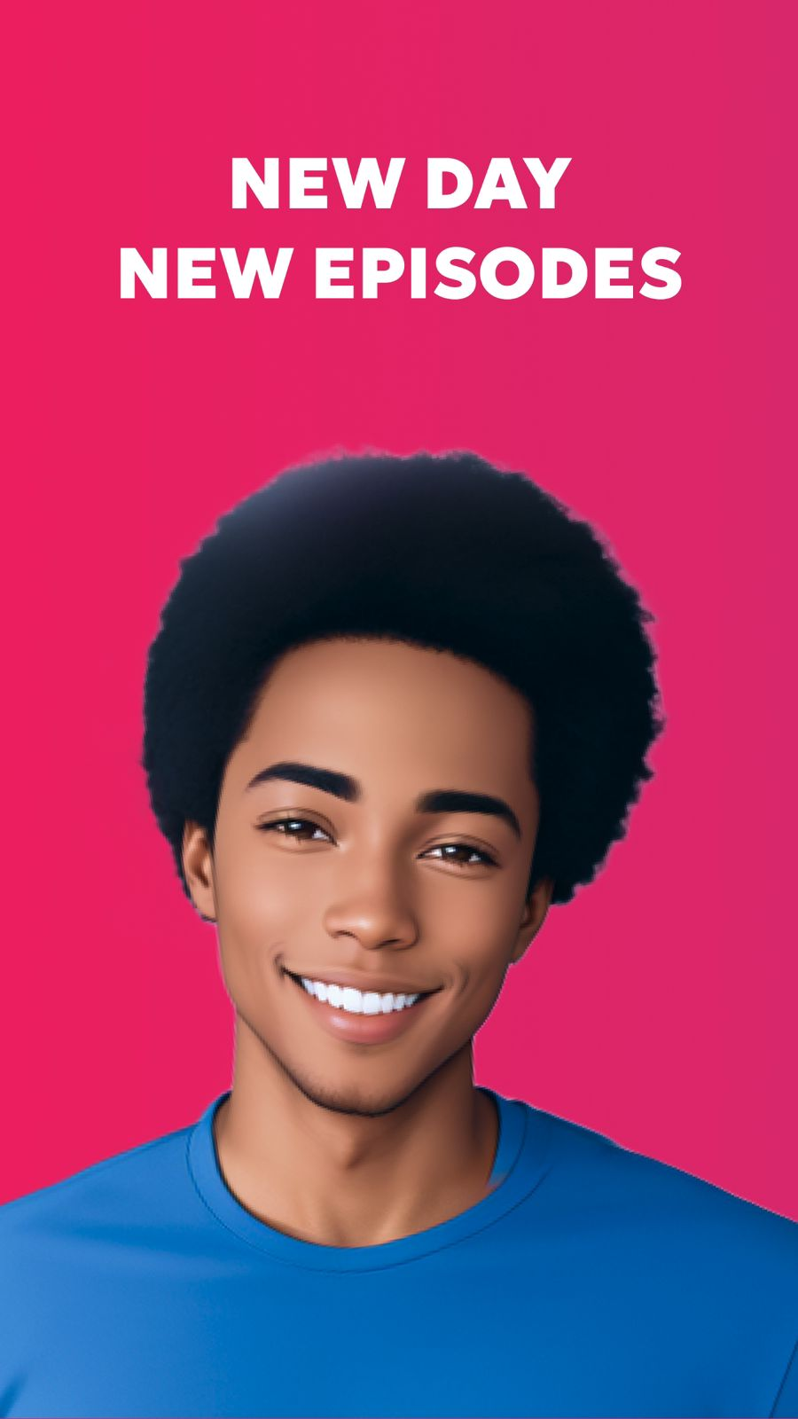
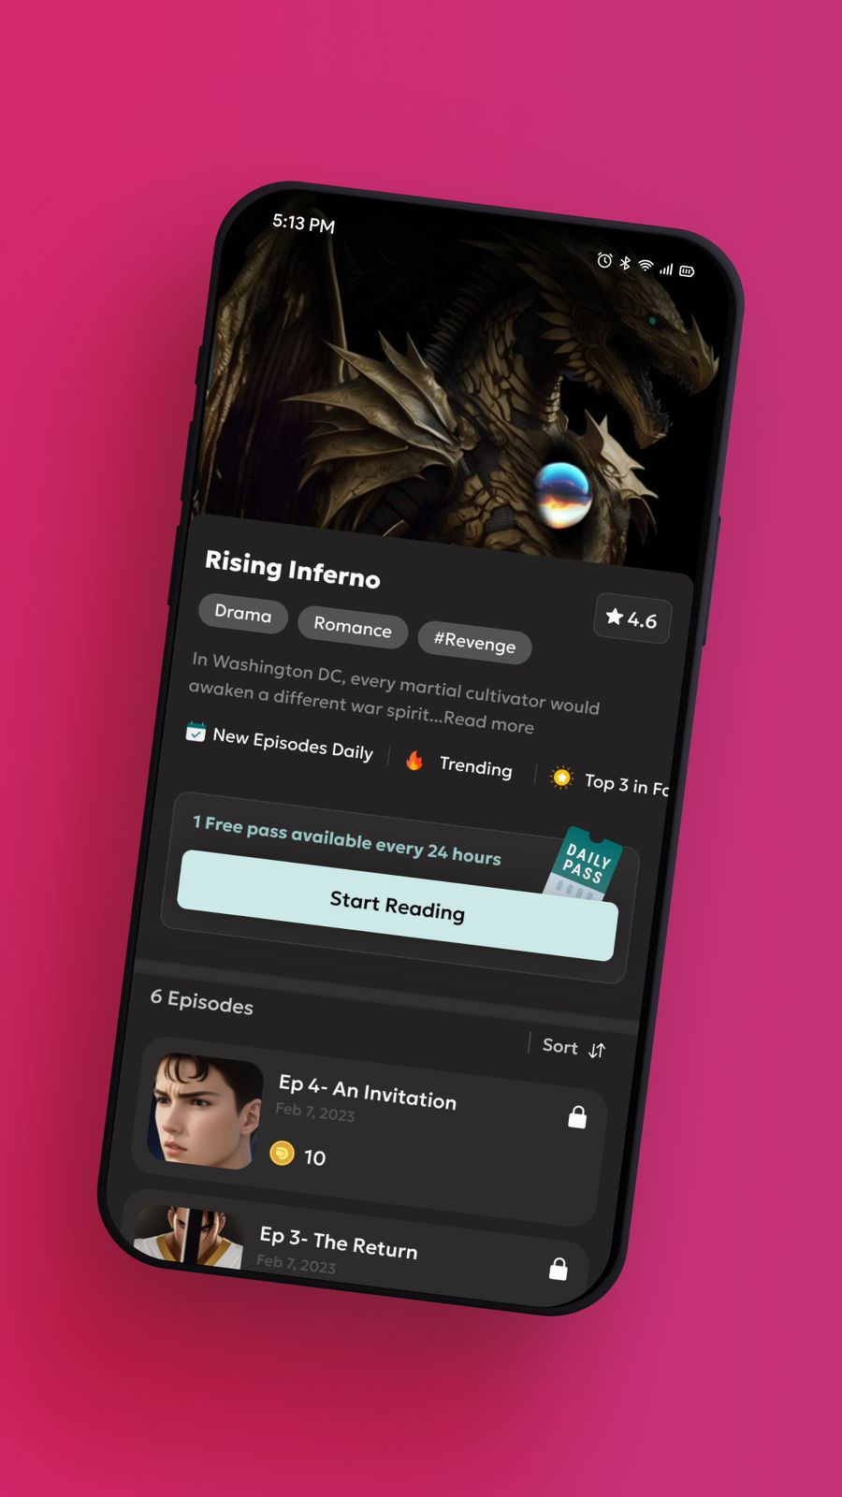
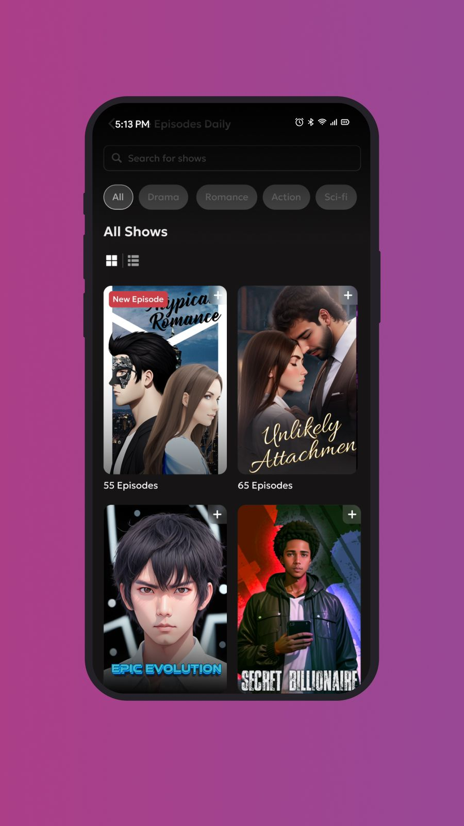
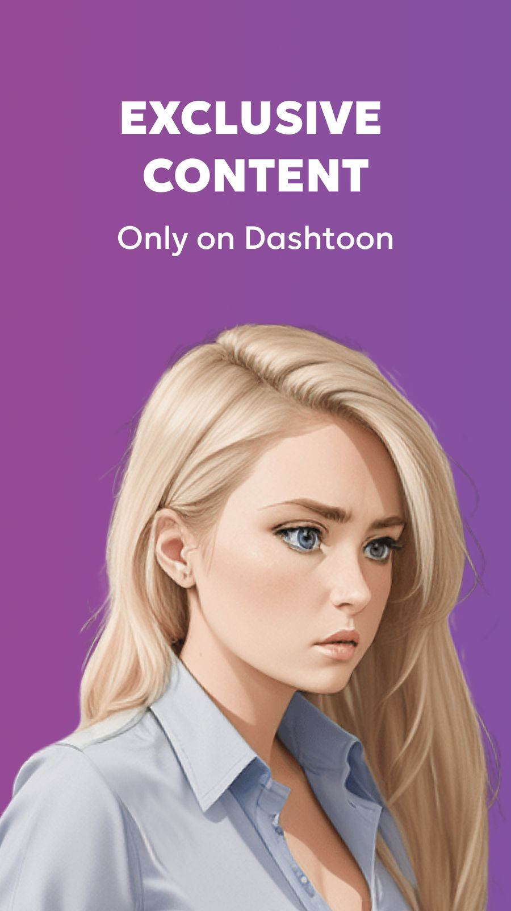
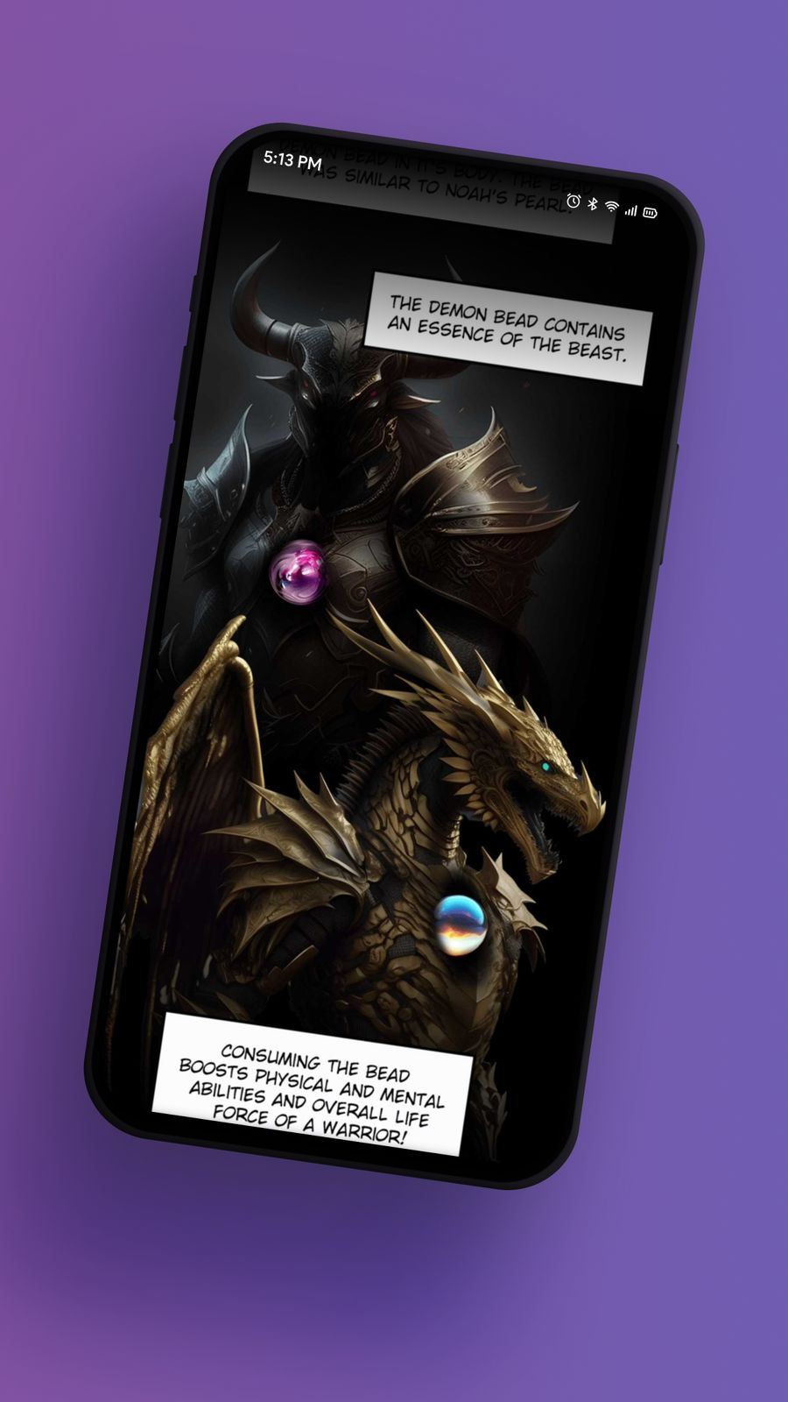
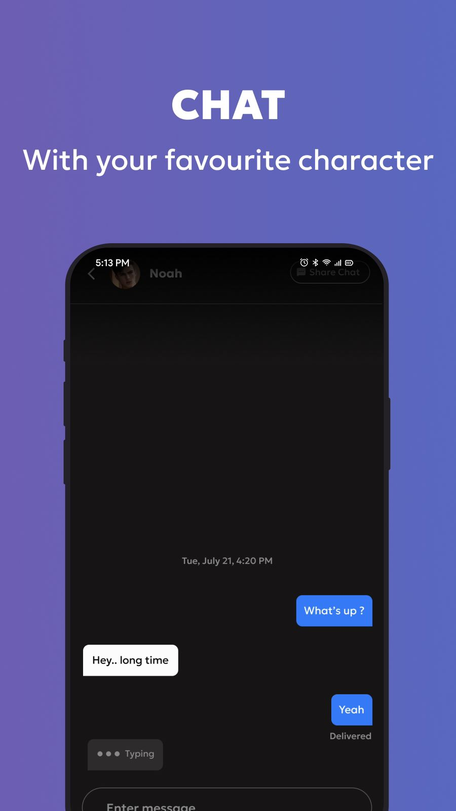
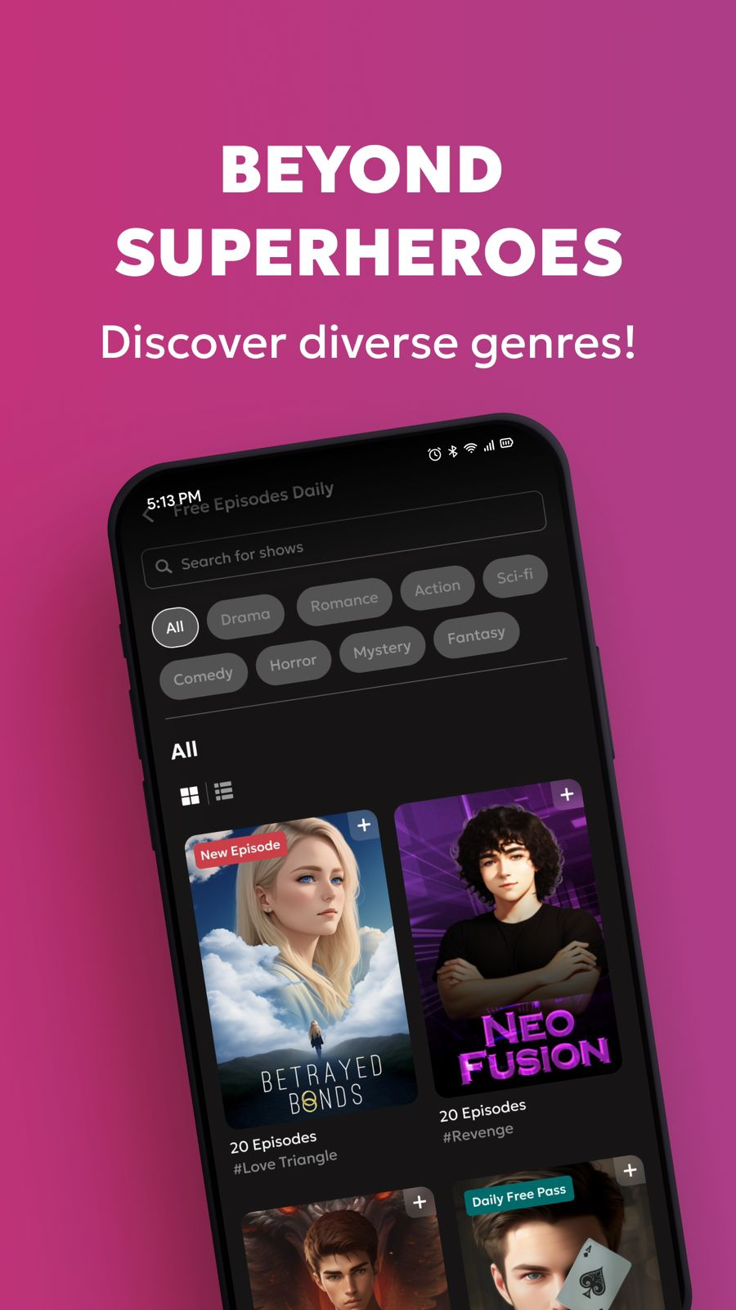
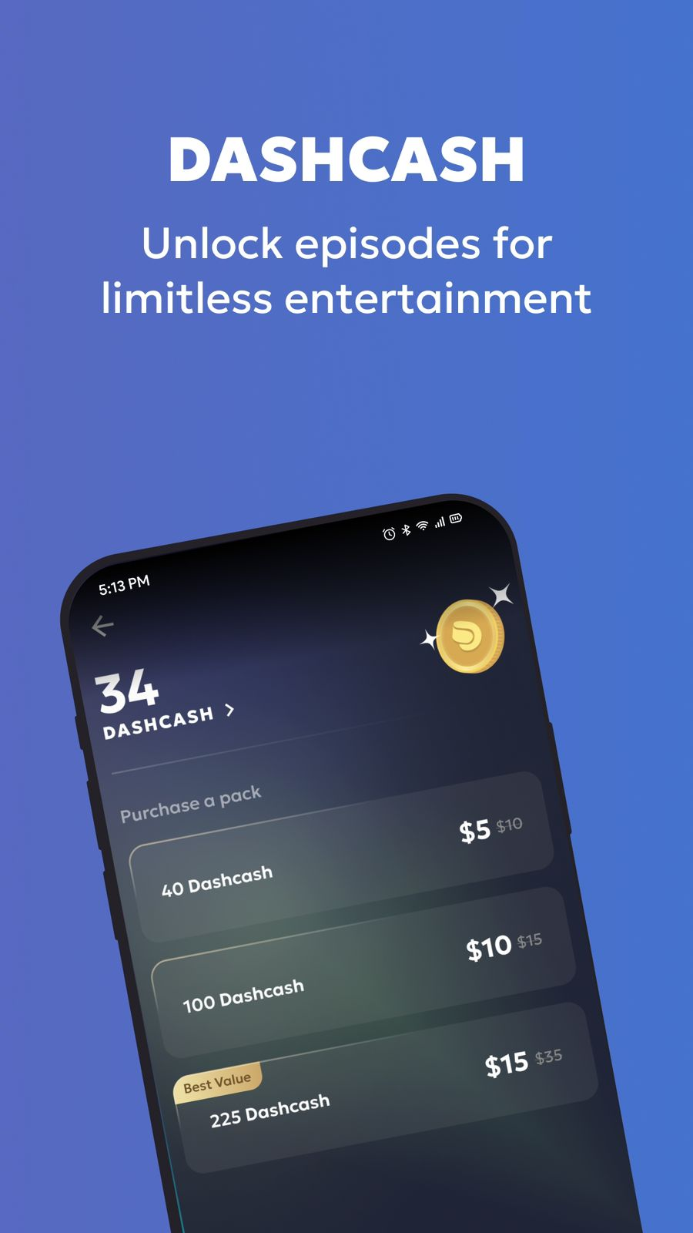
User Experience on Dashtoon
Personalization Features: Dashtoon offers a variety of personalization features that allow users to tailor their experience to their individual preferences. Users can choose from a variety of themes, fonts, and other settings to create a look and feel that they enjoy.
Engagement Metrics: Dashtoon has a high engagement rate, with daily active users (DAUs) that are well above average for similar apps. This suggests that users are enjoying their experience on the app and are coming back for more.
User Ratings and Reviews: Dashtoon has a high user rating and positive reviews. Users praise the app's ease of use, its AI-powered creation tools, and its vast library of content.
Navigation Structure: Dashtoon's navigation structure is intuitive and easy to use. Users can quickly find the content they're looking for, and the app's layout is consistent and organized.
Ease of Use: Dashtoon is a very easy-to-use app. Even users with no prior experience with comics can create their own stories using the app's AI-powered creation tools.

Slide 5
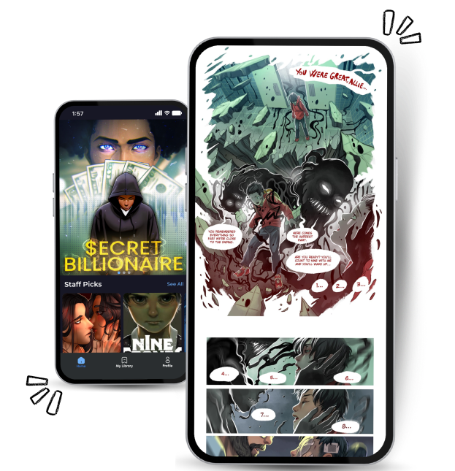
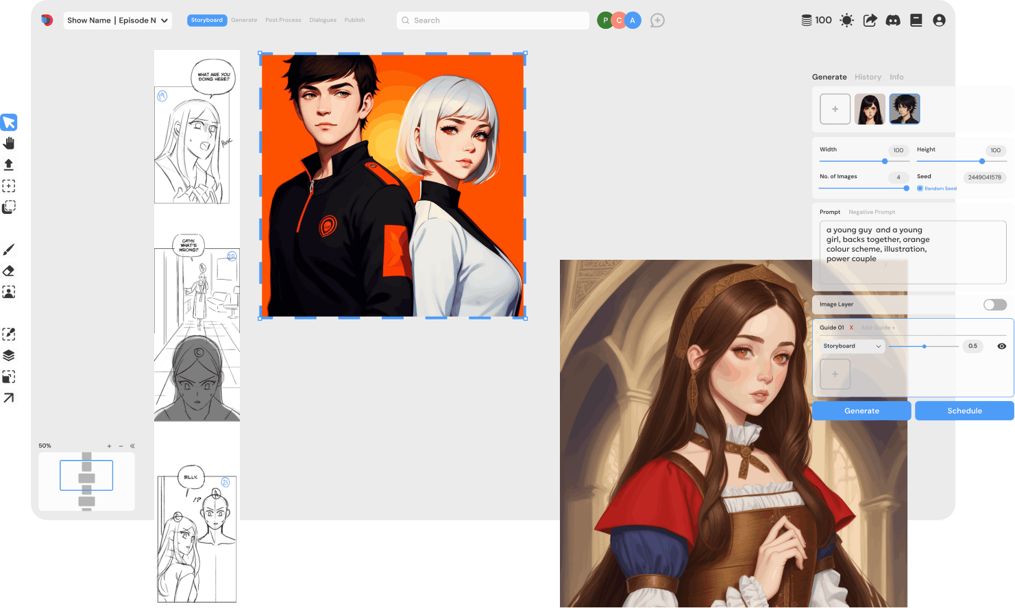
Dashtoon's B2C Business Model
Readers
Creators
Register on Dashtoon app
Register on Dashtoon Studio
Daily Pass : Read a episode of comic
Free
Creating Content Using AI
Premium
Interested in reading more
Post your work on App
No
Dashcash Purchase
No
Yes
Dashcash Remaining
Yes
Access Content Episode
Creator to pay Dashtoon
Remunerate the creator in accordance with the quantity of readers.
Read Episode

Slide 6



Dashtoon's B2C Business Model
Reader Subscription Model:
After the freemium model, Dashtoon introduces Dashcash, a virtual currency. Users purchase Dashcoins to unlock premium content, transitioning behind a paywall after accessing 10 free episodes. This innovative approach fosters reader subscriptions, creating revenue for both creators and Dashtoon..
Freemium Model :
Dashtoon's freemium model balances free and premium content, offering users one free daily episode. This strategy entices users to explore and engage with the platform.
Revenue Generation:
With a robust revenue generation strategy, Dashtoon achieved $15,000 in the first month and aims for substantial growth, targeting $100,000 in monthly revenue within the next two to three months.
Early Traction and Investor Engagement:
Dashtoon has gained early traction with 50 daily storytellers and 25,000 app downloads. Investor confidence is evident in a successful $5 million funding round led by Matrix Partners India and Stellar Venture Partners.
Dashtoon Comic Reader and Dashtoon Studio:
Dashtoon Comic Reader: Positioned as a cornerstone for readers, it employs a freemium structure. After a set number of free episodes, content transitions behind a paywall, creating monetization opportunities for creators and Dashtoon.
Dashtoon Studio: Tailored for creators, the Studio streamlines comic creation with AI-driven tools and an extensive character library. This significantly reduces episode creation time from 40-50 hours to 5-6 hours. Monetization strategies incentivize creators to produce high-quality, engaging content.
Monetization for Creators:
Creators using Dashtoon Studio can distribute their work exclusively on Dashtoon Apps at no cost. If they choose to sell on other channels, fees apply, providing flexibility and options for creators.

Slide 7




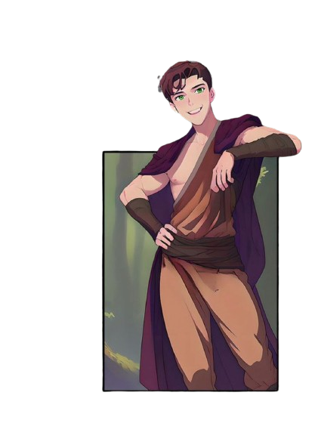




Challenges and Opportunities
Copyright Measures:
One criticism faced by AI-generated content platforms is the potential misuse of copyrighted artwork. Dashtoon combats this by implementing stringent copyright measures. The platform seeds its character library internally with its own IP, including digital art, hand-drawn characters, and photos.
Market Penetration:
Dashtoon faces the challenge of penetrating a market dominated by established Asian content. Overcoming the stronghold of Manga and Webtoons requires strategic efforts to attract a Western audience.
Cultural Adaptation:
The cultural shift in content creation demands Dashtoon to adapt its platform to cater to diverse storytelling styles and preferences. Balancing global appeal while respecting regional nuances poses a significant challenge.
Monetization Skepticism:
Critics may express skepticism about Dashtoon's unique monetization strategies, such as the Dashcash model. The platform must navigate potential resistance and communicate the value proposition effectively.
Skill Gap:
While Dashtoon aims to democratize comic creation, addressing the skill gap among Western creators remains crucial. Encouraging adoption among those without traditional artistic skills poses a challenge.
Community Building and Feedback:
Open communication channels with the Dashtoon community are established to gather feedback and address concerns promptly. The platform is committed to fostering a positive and supportive environment for both creators and readers.

Slide 8
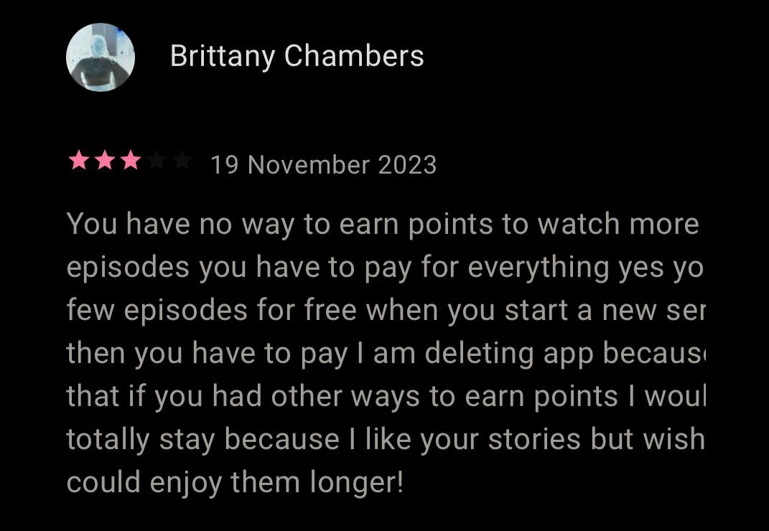
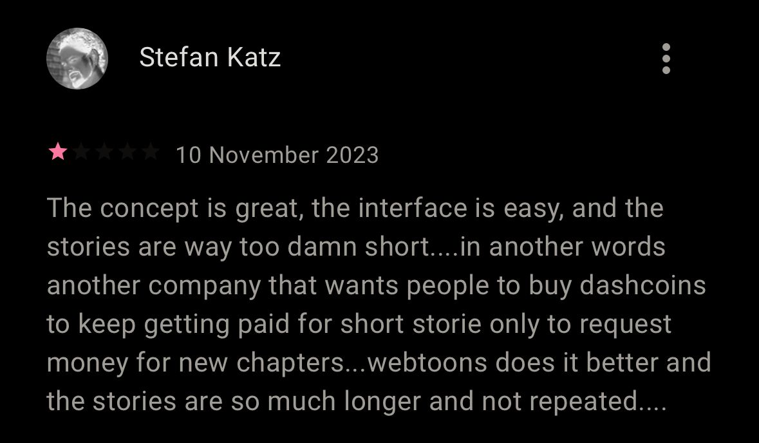
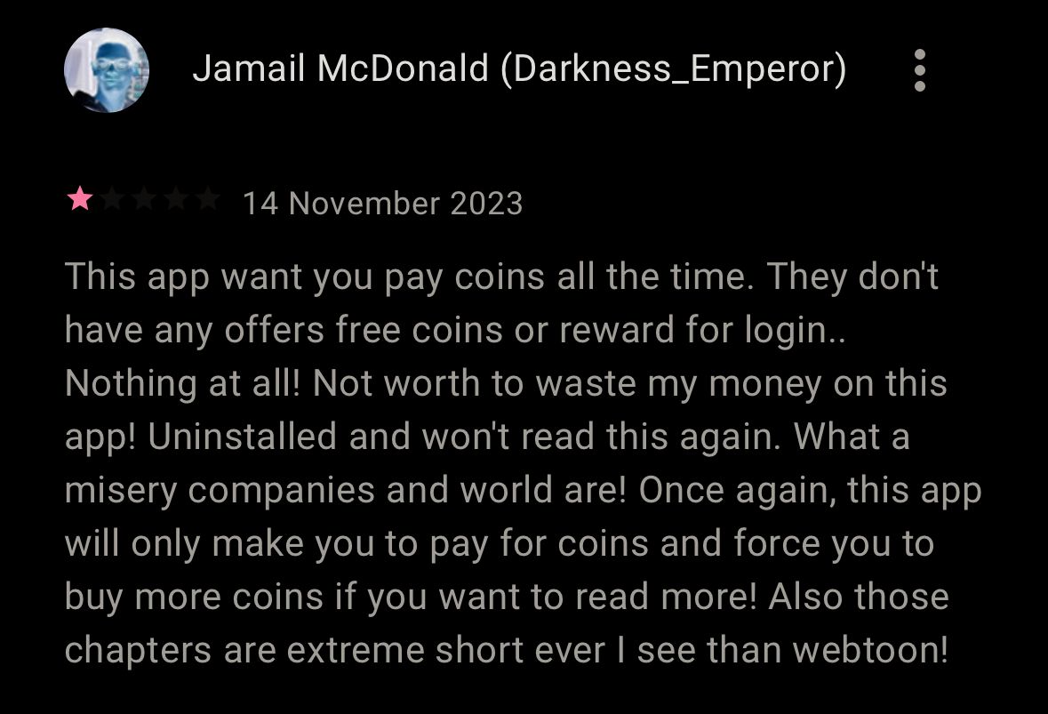
Critics and Improvements
TAKING CONSTRUCTIVE CRITICISM FROM OTHERS IS REQUIRED TO GET TO THE NEXT LEVEL.
Issue: Short Stories and Frequent Coin Purchases
Improvement: Extend the length of the stories to provide users with more substantial content in each episode. Implement occasional promotions or rewards for users, such as free coins or discounts, to enhance the value proposition for frequent readers.
Issue: High Frequency of Coin Purchases and Lack of Incentives
Improvement: Introduce a more rewarding system for users, offering opportunities to earn dashcash through activities like logging in daily, referring friends, or engaging with the platform. Providing occasional promotions or free coin opportunities can encourage user retention.
Issue: Paying for Individual Chapters
Improvement : Consider exploring a subscription model where users pay a fixed amount for unlimited access to a variety of stories or chapters. This could provide a more cost-effective and user-friendly option compared to paying for individual chapters.
Issue: AI-Generated Art Quality
Improvement : Invest in improving the quality of AI-generated art to enhance visual appeal. Implement measures to ensure originality and avoid misleading ads. Transparently communicate the use of AI in the creative process to manage user expectations.
Issue: Limited Access and Technical Glitches
Improvement : Address technical issues promptly to ensure a smooth reading experience. Enhance accessibility options for users, such as quicker loading times and improved navigation. Regularly update the app to fix bugs and address user concerns, demonstrating a commitment to user satisfaction.

Slide 9
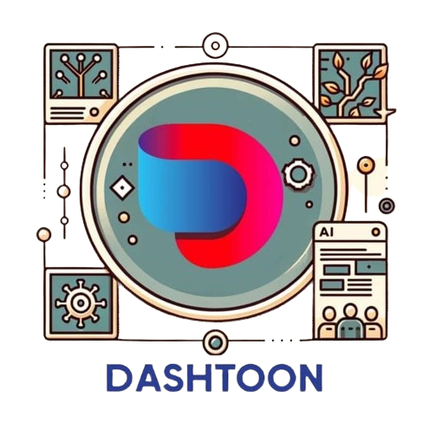



Conclusion
The World’s Best Comics have a new home
Dashtoon turns everyday storytellers into comic creators using its magic AI brushes and a daily dose of episodes.
With Dashtoon, the comic world gets a tech-infused facelift, promising a future filled with more comics, more creators, and maybe a few robot sidekicks.
Dashtoon aims to make comic creation and consumption accessible, fun, and limitless for storytellers and readers globally.
Dashtoon is the rebel of comics, breaking the chains of old-school creation. It dreams of a world where everyone's a comic artist and AI is the friendly assistant, not the boss.
Dashtoon is the rebel of comics, breaking the chains of old-school creation. It dreams of a world where everyone's a comic artist and AI is the friendly assistant, not the boss.
In conclusion, Dashtoon is more than an app; it's a comic hero in the making, ready to conquer the digital comic universe with its quirky charm and AI-powered super moves. The adventure has just begun!

